Slide 1
Identifying ‘avoidable’ ED attendances, and the drivers of ED crowding
Edmund Haacke
Economic and Strategic Analysis, NHS England

Slide 2


Introduction
Projects
ESA_Avoidable_ED_Attendances is an R package to identify 'avoidable' Emergency Department (ED) attendances as per the School of Health and Related Research (ScHARR) at The University of Sheffield’s definition
ESA_ED_Crowding is an R package which implements ESA's work 1) defining three ED crowding metrics, and 2) regression modelling looking at the drivers of ED crowding
Economics & Strategic Analysis
The Economics & Strategic Analysis (ESA) team is a multidisciplinary team of around 45 people, including economists, data scientists, behavioural scientists, operational researchers, statisticians and analysts.
We operate as an in-house consultancy, working on multiple and diverse projects across all areas of the NHS. We work directly with the clients who commission our work to scope out and deliver well-defined, time-limited projects. This enables us to play a central, integral role in influencing and tackling some of the biggest strategic challenges currently facing the NHS.
We provide robust and impactful evidence-based analysis, drawing on advanced analytical capabilities delivered through project-based and cross-cutting work. We use hypothesis-driven techniques to inform and shape solutions to complex, unstructured problems.
Contact
/in/edmundhaacke
edmundhaacke

Slide 3
‘Avoidable’ Emergency Department Attendances

Slide 4



Concepts of ‘avoidable’ ED attendances
From the perspective of the healthcare system, Parkinson et al (2021) suggested ‘avoidable’ attendances can be defined as:
Other teams at NHS England, and across the wider system can easily run the model
Others can build on the model, using their own data to bring in other relevant variables
Other teams at NHS England, and across the wider system can easily run the model
Others can build on the model, using their own data to bring in other relevant variables
Other teams at NHS England, and across the wider system can easily run the model
Others can build on the model, using their own data to bring in other relevant variables
Clinically preventable
Clinically unnecessary
Clinically divertible
Clinical care only available at the ED required
Attendance may have been prevented with earlier intervention or better management of the condition
Potential policy lever: improving access to and quality of primary care services, dependant on conditions targeted.
No clinical care required from healthcare system perspective
May require self-care or other non-clinical care e.g. social services
Potential policy lever: Unlikely to respond to changes in healthcare provision. May respond to population education or better social and welfare services.
Clinical care required, but not of the specialist services provided in the ED
Patient more appropriately treated elsewhere in the healthcare system
Potential policy lever: Likely responsive to increased availability of other health services e.g. general practice and availability of low-intensity urgent services
Our package focuses on ‘clinically divertible’ ED attendances, where a GP appointment may have been a substitute. This is based on an ‘avoidable’ attendances definition from extensive academic research done by University of Sheffield, with input from GP and ED clinicians. These are ‘non-urgent attendances for care that could reasonably have been provided elsewhere’.
Parkinson, B., Meacock, R., Checkland, K., and Sutton, M., (2021). Clarifying the concept of avoidable emergency department attendance. Journal of Health Services Research and Policy, 26 (1).
‘Avoidable’ Emergency Department attendances

Slide 5




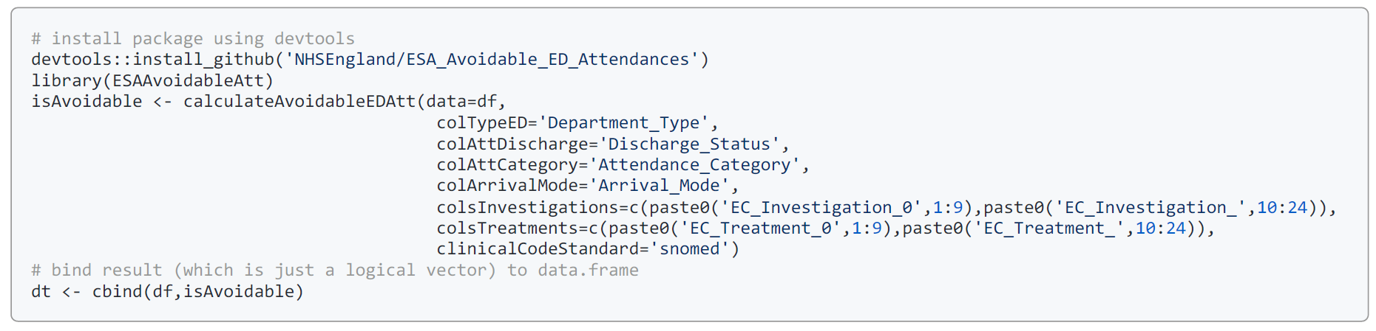
Implementation in R
Other teams at NHS England, and across the wider system can easily run the model
Others can build on the model, using their own data to bring in other relevant variables
Other teams at NHS England, and across the wider system can easily run the model
Others can build on the model, using their own data to bring in other relevant variables
Purpose
02
Package
03
01
Resources
Identifies using Hospital Episode Statistics (HES) or Emergency Care Dataset (ECDS) which attendances were ‘avoidable’ as per the ScHARR definition
R package available on the NHS England GitHub
Built in C++ using the Rcpp package
Multithreading enabled using OpenMP
nhsengland/ESA_Avoidable_ED_Attendances
Database-agnostic – enabling users across the NHS to use their own data, provided the relevant data-points required are present
User-friendly – easy for non-proficient R users to take on
Customizable – utilize different number/time allocation for slots, easily run models for longer ‘queues’ – e.g. 12 hr+ stays
Usage
04

Slide 6
The drivers of crowding in the Emergency Department

Slide 7
Motivation & Contribution
01
02
03
Investigating ED Crowding
Availability of new, more timely data on emergency departments
We use Faster SUS data available in ECDS, with a lag of three days.
Policy shift away from staying times to crowding
Shift led by Clinical Review of Standards, the proposed new standards and the introduction of polices designed to reduce A&E crowding (111 First, 111 Clinical triage, ambulance see and treat etc.).
Evidence gap
We may know what we think is driving crowding, but we do not know to what extent. Econometrics techniques are better than correlations as they can help us isolate the extent to which individual factors are driving crowding.
Our contribution
To the best of our knowledge our analysis quantifies robustly, for the first time, the effect of key factors on ED crowding.
We isolate and quantify the effect of each factor of crowding we consider.
We develop 3 new ED crowding metrics.
What drives crowding in type 1 A&E departments?
Our analysis aims to take a whole system approach looking at the drivers of crowding covering pre-hospital, within A&E, rest of hospital and wider healthcare capacity.
Previous work by Economics & Strategic Analysis Team
Rising bed occupancy reduces performance against the 4-hour standard, with accelerating effects above 92% and discharges on the day and previous days’ improve performance.
Paling, S., Lambert, J., Clouting, J., González-Esquerré, J., and Auterson, T. (2020). Waiting times in emergency departments: exploring the factors associated with longer patient waits for emergency care in England using routinely collected daily data. Emergency Medicine Journal.
The drivers of crowding in the Emergency Departments

Slide 8









How we measure Emergency Department crowding
Overall crowding: Number of patients staying at ED. This metric counts the number of patients who are present at each time slot irrespective of whether they were discharged in a later slot or arrived in an earlier one.
Slots
Each day is split into six separate 4-hour time slots:
00:00 – 03:59
04:00 – 07:59
08:00 – 11:59
12:00 – 15:59
16:00 – 19:59
20:00 – 23:59
Acuity
We create separate models for three patient types: majors, minors and resus.
This work has been written up for academic publication. The paper collapses the slots to day level.
6 hours + stays: Number of patients staying longer than 6 hours at ED. This is a subset of the overall crowding metric. It counts the number of patients who would have been staying for 6+ hours by the end of the slot or their discharge time – whichever is earlier.
Cubicle crowding: Number of majors and resus patients staying in the ED per cubicles (majors and resus). We sum the overall crowding metric for majors and resus patients (for a given site/day/time slot) and divide by the number of majors + resus cubicles for that site. The result is a number that tells us how many patients are staying per cubicle.
Majors are patients with more complicated injuries or illnesses, such as shortness of breath or hip injuries.
Minors are the least seriously injured or ill patients, such as ankle or wrist injuries.
Crowding is expected to be less of a problem in resus, as these are the most seriously injured or ill patients.

Slide 9




Our econometric model
Econometric analysis enables us to isolate the impact of the different factors on crowding in ED’s. Modelling allows us to show the effect of each individual variable once we keep the values of the other variables fixed.
There may be unobserved variation between sites, and whilst we cannot directly measure the effect of these factors on crowding, provided they do not vary much over time, our modelling approach minimizes the danger that our results are affected by their non-inclusion.
Note that based on clinical input, we use over 75 year old as a proxy for frailty.
Overall crowding
6+ hour stays
Our approach: we created separate models to look at three measures of crowding for three patient types: majors, minors and resus. We estimate the effect of the various factors (see below) on “overall crowding” and “6+ hour stays” for each of the six slots and patient types. We also estimate models for “cubicle crowding” (majors+resus patients) for each of the six slots.
Cubicle crowding
Pre-hospital | Controls and time effects | Within ED | Rest of hospital capacity | Wider healthcare capacity
Arrival mode Referral source | Patients over 75* Ethnicity Deprivation Sex Day of the week Bank holiday Month | Complaint (MAU) Investigation Diagnosis | G&A bed occupancy ACC bed occupancy Number of long stay patients (21+ day) Admitted patient transfers between specialties/site/both Number of inpatients in each specialty Share of admitted patients from ED | Fit-for-discharge patients that were not discharged

Slide 10

Implementation in R
Other teams at NHS England, and across the wider system can easily run the model
Others can build on the model, using their own data to bring in other relevant variables
Other teams at NHS England, and across the wider system can easily run the model
Others can build on the model, using their own data to bring in other relevant variables
What we did
02
01
Open Source
Usage
04
Developed a package in R, available on the NHS England GitHub
Database-agnostic – enabling users across the NHS to use their own data, provided the relevant data-points required are present
User-friendly – easy for non-proficient R users to take on
Customizable – utilize different number/time allocation for slots, easily run models for longer ‘queues’ – e.g. 12 hr+ stays
Other teams at NHS England, and across the wider system can easily run the model
Others can build on the model, using their own data to bring in other relevant variables
ED Crowding in March 21 to October 21
ED Crowding in November 21 to March 22
Ambulance handover delays (adapted) in November 21 to March 22
ED Crowding in April 21 to August 22
Ambulance handover delays (adapted) in April 21 to August 22
Database-agnostic – enabling users across the NHS to use their own data, provided the relevant data-points required are present
User-friendly – easy for non-proficient R users to take on
Customizable – utilize different number/time allocation for slots, easily run models for longer ‘queues’ – e.g. 12 hr+ stays
03
Resources
GitHub: https://github.com/nhsengland/ESA_ED_Crowding
AnalystX Mini-huddle (video recording): Mini-Huddle: Drivers of crowding in type 1 EDs: econometric model and its implementation in R - AnalystX - FutureNHS Collaboration Platform
An example of how to use the package can be found on the GitHub

Slide 11
Packages
01
02
03
04
data.table
An efficient and highly performant improvement on the default data.frame.
Considered as one of the fastest packages for working with data, and able to cope with very large amounts.
R6
Lightweight, fast and simple implementation of encapsulated (classical) object-orientated programming for R.
Supports private & public members and inheritance (including across packages).
fixest
C++ backed and parallerized package for fast and user-friendly estimation of fixed effects regression models.
Supports OLS, Poisson and Negative Binominal models.
Other
ggplot2: used for some plotting
odbc & DBI: loading data from SQL servers
gt: creating HTML tables to display results

Slide 12
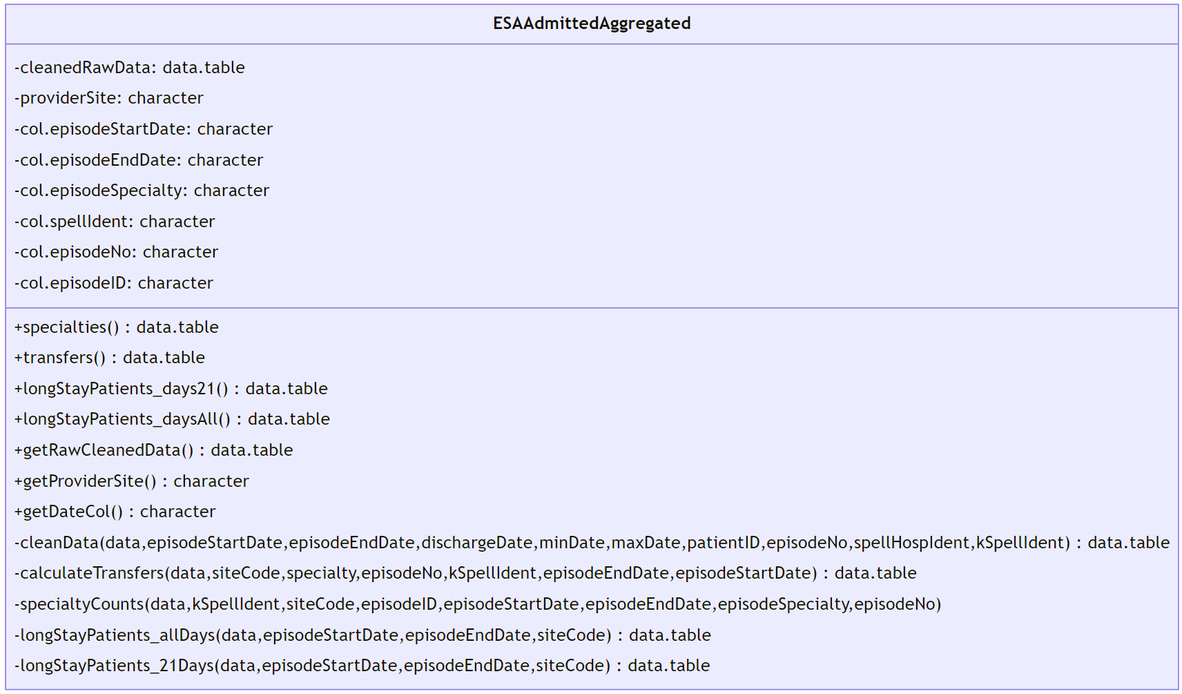
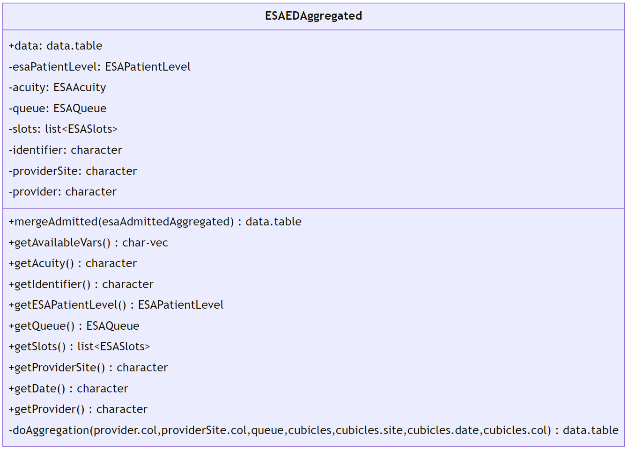
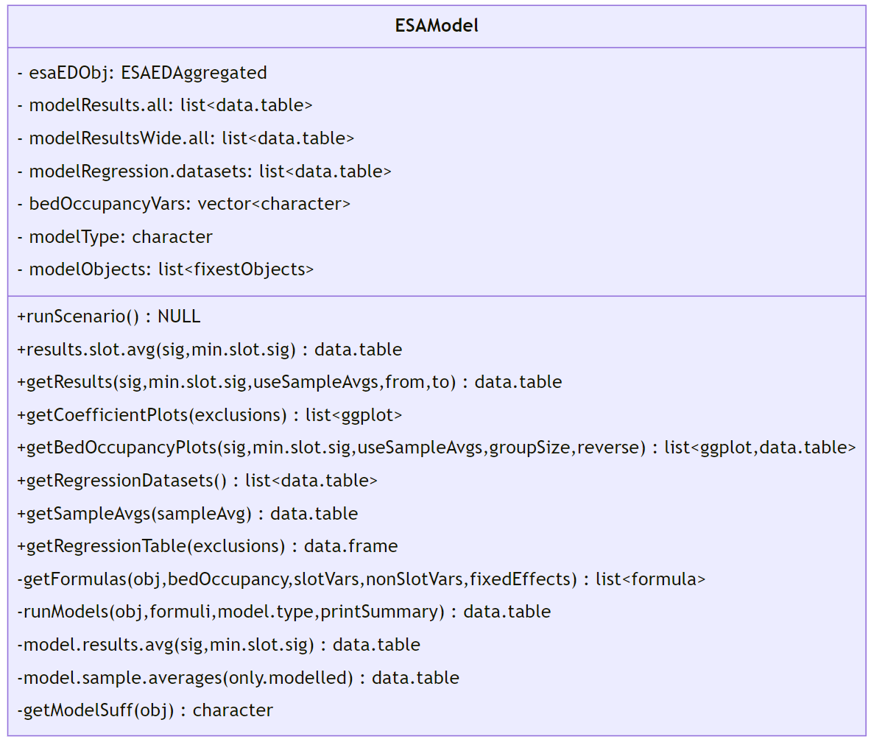
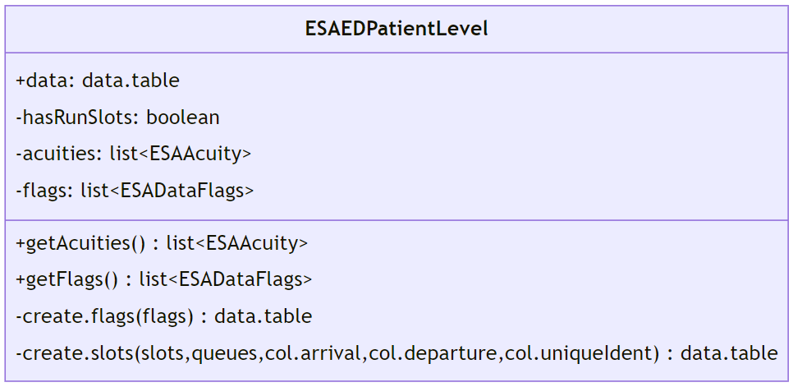
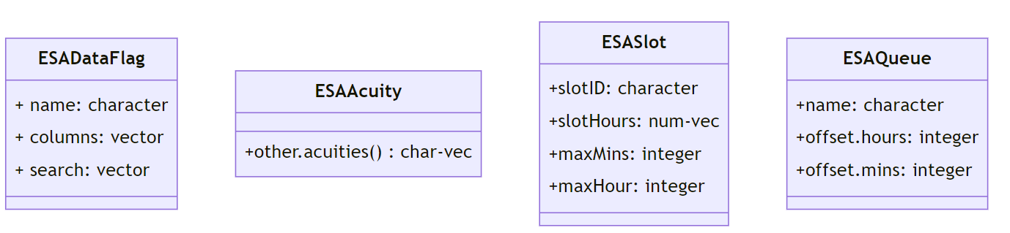
Class diagram

Slide 13
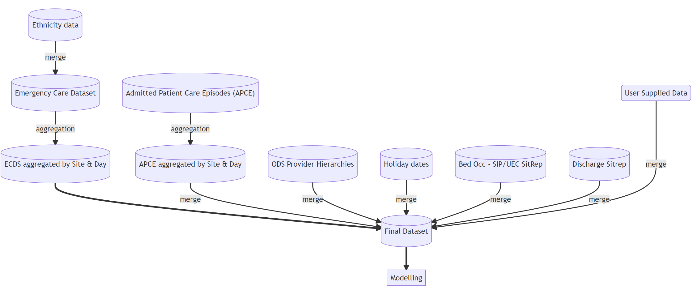
Data Flows
This example is based on national administrative data. However, the package has been structured in such a way that users can provide their own data, provided the data contains the relevant data points required.
ESAEDPatientLevel
ESAAdmittedAggregated
ESAEDAggregated
ESAModel

Slide 14
Acknowledgements
‘Avoidable’ Emergency Department attendances
Svetlana Batrakova, Assistant Director, ESA
Shyam Lamba, Senior Economic Manager, ESA
Katie Fozzard, Senior Economic Manager, ESA
Drivers of Emergency Department Crowding
Steven Paling, Deputy Director, ESA
Svetlana Batrakova, Assistant Director, ESA
Dimitris Pipinis, Senior Economic Manager, ESA
Ranya Alakraa, Senior Economic Manager, ESA (formerly)
Daniel Boden, Emergency Medicine Consultant, ECIST Regional Clinical Director and NHSE Regional Advisor
Contact
/in/edmundhaacke
edmundhaacke
Questions…?

